Slide 1
Zwiebeln schälen
Workshop – NET Day Franken 2023

Slide 2
Agenda
Wir lernen uns kennen
Begegnungen mit bekannten Architekturmustern
Fleissige Bienchen erstellen erste Waben
M-i-t-t-a-g-s-p-a-u-s-e
Zwiebeln schälen bis die Augen tränen
Der große Architektur-Eintopf
Tagesrückblick und Take-Aways

Slide 3
Über mich

Slide 4
Über euch

Slide 5
Architektur Overflow
Hexagonal Architecture
Onion Architecture
The Clean Architecture
Screaming Architecture
Layered Architecture
Multi-Tier Architecture
Lean Architecture

Slide 6
Hexagonale Architektur
2005 von Alistair Cockburn vorgestellt
aka „Ports & Adapters“
Hat sich selbst nach mehreren Jahren entschl. sie P & A zu nennen.
Fachlichkeit im Mittelpunkt einer Anwendung.

Slide 7
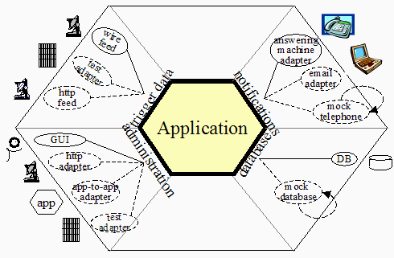
Hexagonale Architektur
Quelle: https://alistair.cockburn.us/hexagonal-architecture/

Slide 8
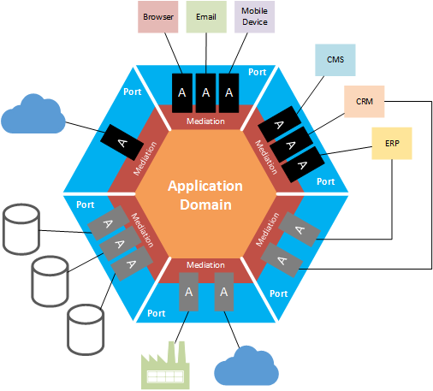
Hexagonale Architektur
Quelle: Charles Young (http://geekswithblogs.net/cyoung/archive/2014/12/20/hexagonal-architecturendashthe-great-reconciler.aspx)

Slide 9
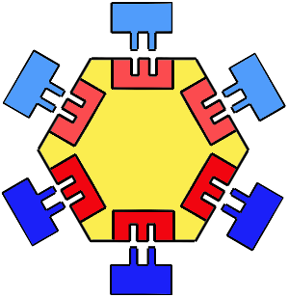
Hexagonale Architektur
Quelle: http://www.dossier-andreas.net/software_architecture/ports_and_adapters.html

Slide 10
Hexagonale Architektur
Consolen Adapter
Adapters
IUserManagementService
Ports
Primäre Ports und Adapter
Core-Logic
UserManagementService
User
IUserRepository
Sekundäre Ports und Adapter
UserFileRepository

Slide 11
Onion Architecture
2008 von Jeffrey Palermo vorgestellt
„This architecture is unashamedly biased toward object-oriented programming, and it puts objects before all others.“ – J.P.
“The Onion Architecture relies heavily on the Dependency Inversion principle” – J.P.
„The database is not the center. It is external.“ – J.P.
“Externalize infrastructure and write adapter code so that the infrastructure does not become tightly coupled.” – J.P.

Slide 12
Onion Architecture
User Interface
Application Services
DB
Domain Services
Domain Model
File
Application Core
Tests
Infrastructure
Services
Email

Slide 13
Onion Architecture – Bsp. Mitarbeiter Website
EmployeeController
User Interface
IEmailSender
Application Services
Domain Services
IEmployeeRepository
Domain Model
SmtpEmailSender
Tests
Infrastructure
Employee
EntityFrameworkEmployeeRepository

Slide 14
Onion Architecture
"With traditionally layered architecture, a layer can only call the layer directly beneath it. This is one of the key points that makes Onion Architecture different from traditional layered architecture." – Palermo

Slide 15
Onion Architecture - Zugriffe
User Interface
Application Services
Domain Model
Tests
Domain Services
Infrastructure

Slide 16
Grundsätze der Onion Architecture
The application is built around an independent object model.
Inner layers define interfaces. Outer layers implement interfaces.
Direction of coupling is toward the center.
All application core code can be compiled and run separate from infrastructure.

Slide 17
Screaming Architecture
2011 von Robert C. Martin (Uncle Bob) vorgestellt.
Keine „echte“ Architektur.

Slide 18
Screaming Architecture – High Level
Was schreit deine Applikations-Architektur?
Gesundheitssystem
oder Buchhaltung
oder Lagerverwaltung?
oder etwas wie
Rails
oder Spring/NHibernate
oder ASP.NET Core?
oder WPF
oder EntityFramework

Slide 19
Screaming Architecture – Theme
A use case driven approach.
Architectures are not (or should not) be about frameworks.
Architectures should not be supplied by frameworks.
If your architecture is based on frameworks, then it cannot be based on your use cases.

Slide 20
Screaming Architecture – Purpose
A good software architecture allows decisions about frameworks, databases, web-servers, and other environmental issues and tools, to be deferred and delayed.
A good architecture makes it easy to change your mind about those decisions too.
A good architecture emphasizes the use-cases and decouples them from peripheral concerns.

Slide 21
The Clean Architecture
2012 von Robert C. Martin (Uncle Bob) vorgestellt
Mit Verweis auf
Hexagonal Architecture
Onion Architecture
Screaming Architecture
...DCI...BCE
Ein Extrakt / eine Zusammenfassung.

Slide 22
The Clean Architecture
Independent of Frameworks. The architecture does not depend on the existence of some library of feature laden software. This allows you to use such frameworks as tools, rather than having to cram your system into their limited constraints.
Testable. The business rules can be tested without the UI, Database, Web Server, or any other external element.
Independent of UI. The UI can change easily, without changing the rest of the system. A Web UI could be replaced with a console UI, for example, without changing the business rules.
Independent of Database. You can swap out Oracle or SQL Server, for Mongo, BigTable, CouchDB, or something else. Your business rules are not bound to the database.
Independent of any external agency. In fact your business rules simply don’t know anything at all about the outside world.

Slide 23
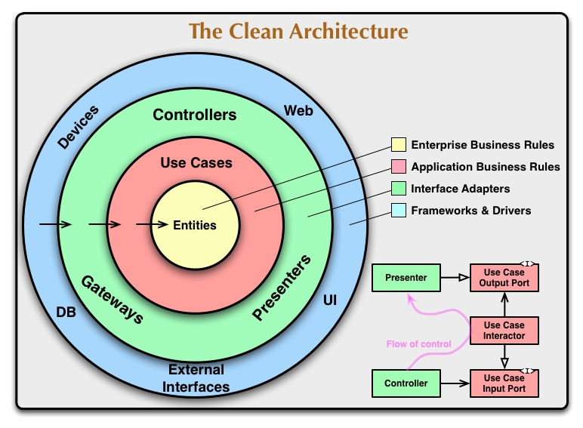
The Clean Architecture
Quelle: Robert C. Martin (https://blog.cleancoder.com/uncle-bob/2012/08/13/the-clean-architecture.html)

Slide 24
The Clean Architecture – Dependency Rule
Dependency Rule
Quelle: Robert C. Martin (https://blog.cleancoder.com/uncle-bob/2012/08/13/the-clean-architecture.html)

Slide 25
Gemeinsamkeiten

Slide 26
Separation of Concerns

Slide 27
Testability

Slide 28
Dependency Inversion Principle

Slide 29
Dependencies, Dependencies, Dependencies

Slide 30
Abstractions should not depend upon details. Details should depend upon abstractions.
Agile Principles, Patterns, and Practices in C#, Robert C. Martin

Slide 31
Ende Einführung Theorie

Slide 32

Fleissige Bienchen erstellen erste Waben
Photo credit: Carbon Arc on Visualhunt

Slide 33
Danke

